Slide 1

IAIA Project 2024
IAIA Project #2
Gomoku Game Automation Using UR5E Robot Arm
School of Mechanical and Control Engineering Kwak, Jin(21900031)
Lim, Soonho(21900610)
An, Gyeonheal(21900416)
Han, Taegeon(21900793)
24.10.04
Industrial AI and Automation
Prof. Young-Keun Kim
Notes:
Hello every one, Im presenter sunwoo and my prartner is 곽진. today im going to present our project on ‘제목’

Slide 2
1. Background
1) Gomoku Game with Computer in Real Life
2) Perform action with UR5E(Robot Arm)
Coil fault may cause issues with the cooling motor → Vibration patterns changes.
The goal is to identify these changes to diagnose the issue early on.
Notes:
First the back ground of
primarily high power consumption and coil defects that lead to overheating and irregular temperature transmission.

Slide 3
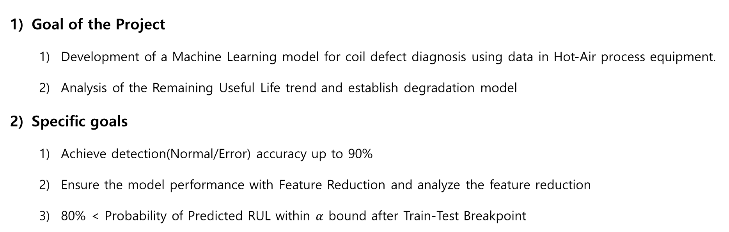
2. Problem Statement
Goal of the Project
Development of a Machine Learning model for coil defect diagnosis using data in Hot-Air process equipment.
Analysis of the Remaining Useful Life trend and establish degradation model
Specific goals
Achieve detection(Normal/Error) accuracy up to 90%
Ensure the model performance with Feature Reduction and analyze the feature reduction
80% < Probability of Predicted RUL within $α$ bound after Train-Test Breakpoint
Notes:
The main goal of our project is to develop a machine learning-based model to detect coil defects in hot-air drying process equipment. Additionally, we aim to predict the Remaining Useful Life (RUL) of the equipment to proactively address potential failures.
Specifically, we want to achieve a detection accuracy of over 90% for identifying defects and ensure that 80% of our RUL predictions fall within an acceptable margin of error after our model is trained and tested. This will not only help us prevent coil-related failures but also ensure better equipment management and productivity.

Slide 4
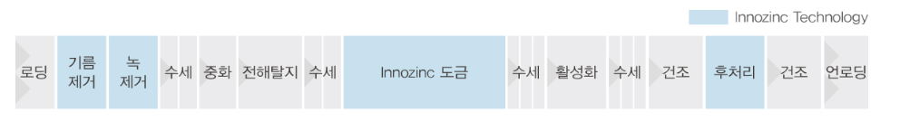
3. Dataset
Dataset name : AI dataset for early detection of equipment abnormalities
Data Measurement
PLC data (Sampling period: 5 [sec])
Sound data
Data Categories
Numerical Data : Temperature, Current
Sound Data : 185 data, 30sec per track. Subdivided into Error and Normal
Error Lot list: Process number, Error Number
5) Data type
Supervised Learning-Based Data
Time series data
Numerical(Float/ .csv) and Sound data(.wav)
6) Data Output
- Classification: Normal / Error
7) Data input
 | Attribute | Explain
Input | Index | Auto-generated value when collecting data
 | Process | Tracking the process by assigning the same number to the same process
 | Time | Recording time down to seconds in the format (H:MM:SS)
 | Temp | Temperature within the hot-air drying system
 | Current | Current within the hot-air drying system
Error | 1-11 | Error Number

Slide 5
4. Method
Data Preprocessing
Feature Extraction and Analysis
Feature Selection /Reduction
Discussion & Conclusion
RUL Estimation
Fault monitoring and warning

Slide 6
5. Expected outcome
The process is used in various fields. (e.g. electronic component coating, automotive paint processes, and ceramic processes) Applying model to hot-air process may prevent product damages caused by coil failures.
Before: Difficulty on immediate problem check of coil defects on-site on real-time base. After: Respond quickly to equipment fault → Benefits on equipment management and productivity.

Slide 7
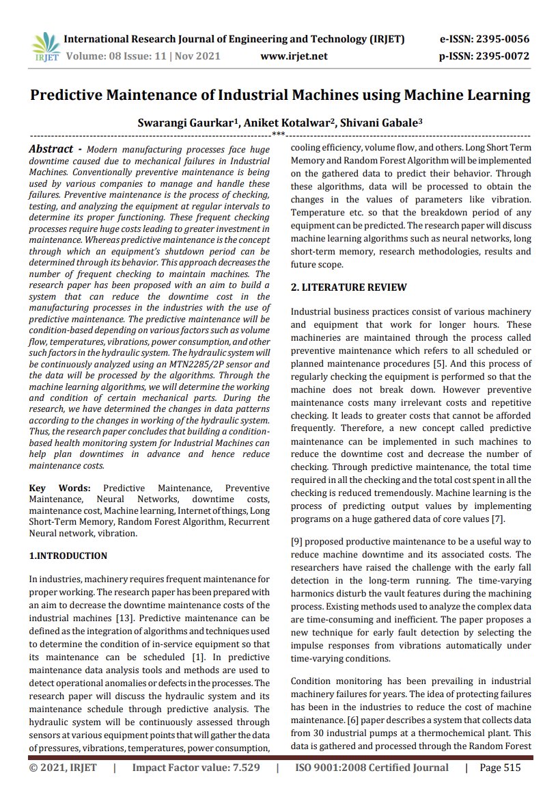
6. Paper Review
1) Paper information
Gaurkar, Swarangi, Aniket Kotalwar, and Shivani Gabale. "Predictive maintenance of industrial machines using machine learning." Int Res J Eng Technol (2021).
2) Explaination
Sensor data of hydraulic system : pressure, vibration, temperature, power consumption, etc.
RUL of the hydraulic system is predicted by ML methods e.g. LSTM or random forest model.
3) Application on the Project
Predicting the RUL of a facility using:
Vibration(counterpart of sound)
Temperature
Power(counterpart of current) data

Slide 8
7. Schedule

Slide 9
8. References
[1] (주) KEMP, Innozinc 세라믹 아연도금, http://kempkorea.com/
[2] Gaurkar, Swarangi, Aniket Kotalwar, and Shivani Gabale. "Predictive maintenance of industrial machines using machine learning." Int Res J Eng Technol (2021).

